Slide 1
Quantum Computing for Linear Algebra
By: Arnav Kalotra
University of Maryland College Park
Patuxent Partnership

Slide 2

Qiskit
Python Based Language
Available for everyone
Ability to connect and use quantum computers

Slide 3

Advantages and Disadvantages
Computational power
Exponentially more memory
High ceiling
Ability to model complex systems
Expensive
Inputting Data
Precision of Algorithms
Potential Security Threat
Repeated Computations
Notes:
Can talk about amplitude/ hamiltonian encoding here , can model biological processes/ chemical reactions etc.

Slide 4
What is Quantum computing?
Classical Computer bits are either 0 and 1
Quantum Qubits are uncertain - probabilities of observing 0 or 1
1 bit in Classic Vs Quantum (Exponential increase in Memory)
Classical probability (one real #): x
Quantum probability (1 complex #): x+iy
Probabilites converted into Polar Coordinates r, θ (x+iy→ r*e^{i*Θ})
Notes:
Exponential increase in memory due to the use of probabilities
Probabilities means that computations must be done repeatedly

Slide 5
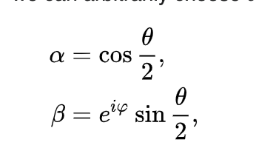
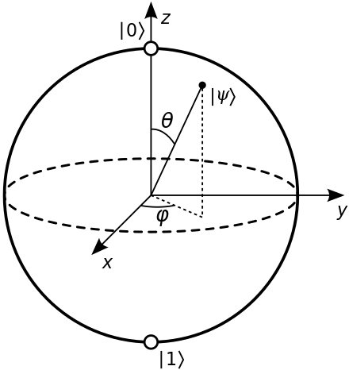
Bloch Sphere (single bit)
Each point on the surface of this sphere is a quantum state
North and South pole (classical)
Any point on Equator= 50/50 probability
Every other point: superposition of 0 and 1
r1²+r2²=1 (Physics nobel prize 1954)
Relative Phase is along the equator
**graphical representation of one qubit**
Notes:
statistical interpretation of the wave function

Slide 6
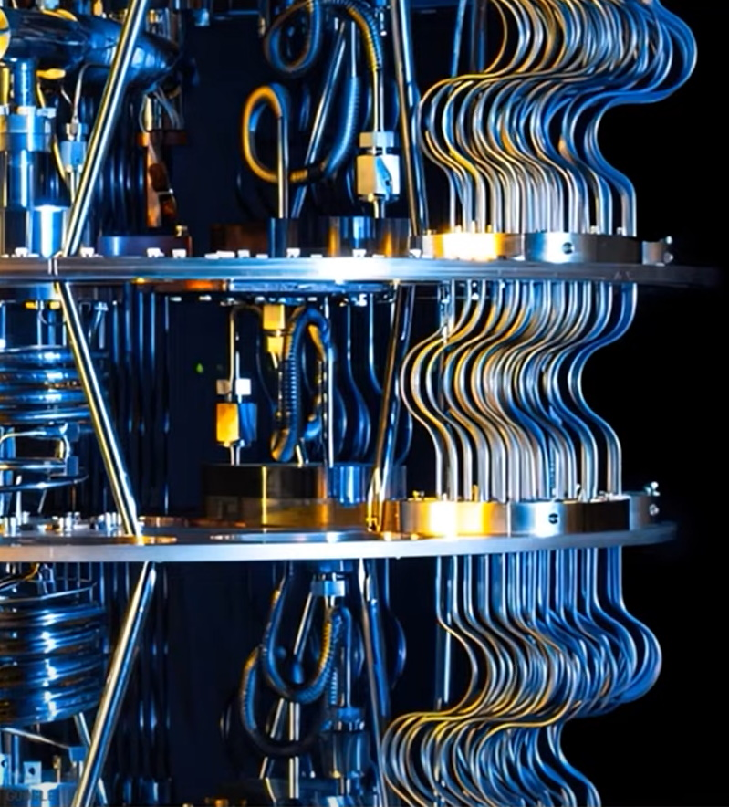
Quantum Programming
Only two core concepts in Quantum programming, Gate and State
Mathematically a State: vector Gate: Matrix
State is essentially where on the Bloch sphere the Bit is
A Gate is something that alters that Location
States are transformed through Matrix vector multiplication
Notes:
Quantum programming is nothing but traveling from state to state and the final state is just a sample of the final answer (repeated calculations)

Slide 7
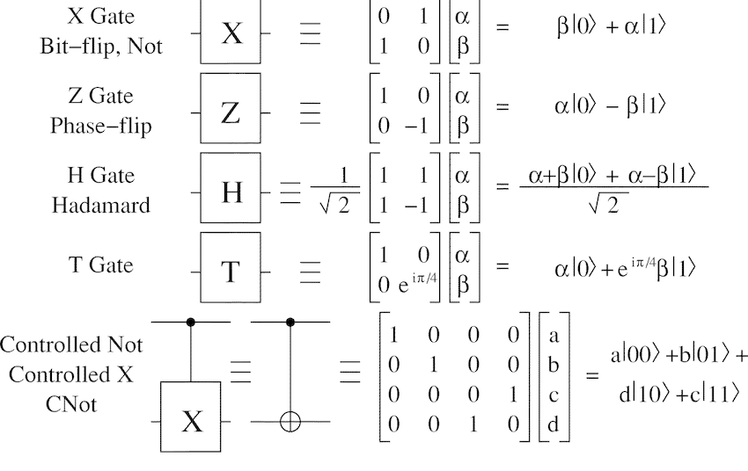
Logic Gates
-Hadamard Gate (H)
-Flip Gate (X)
-Rotate Gate (T-45,Z-180)
-If Gate (CNOT
*1 bit gate is 2x2, 2 bit gate is 4x4 etc.*
1 bit state is 2x1, 2 bit state is 4x1

Slide 8
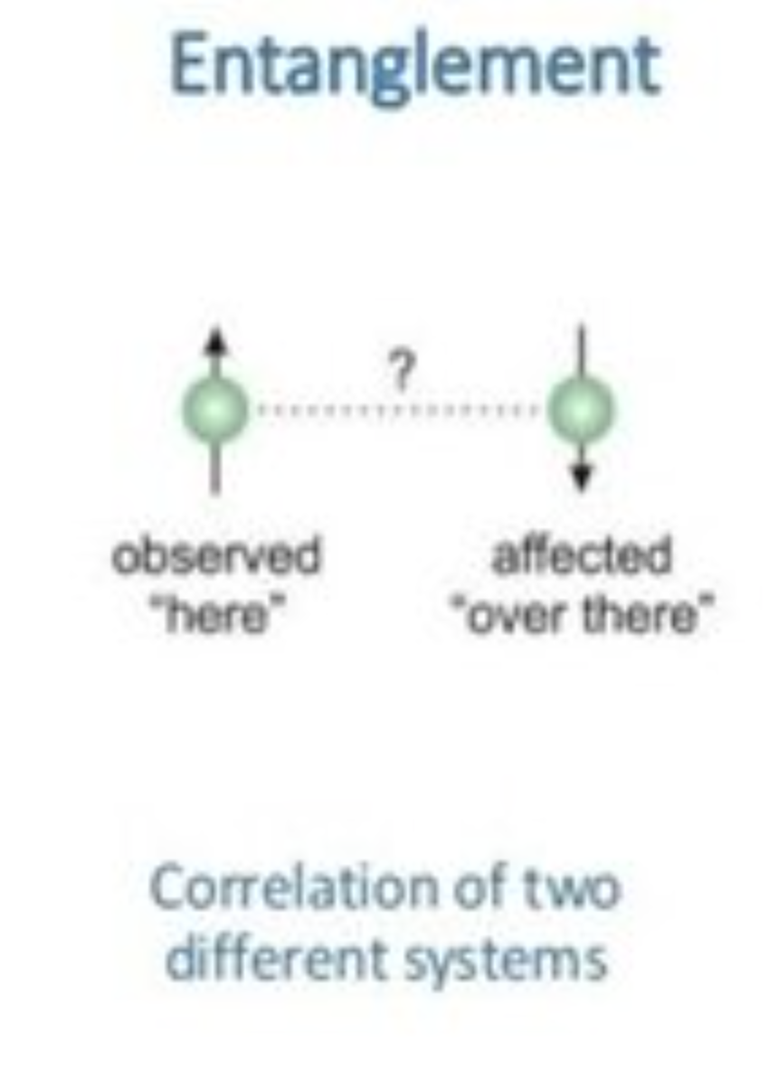
Quantum Circuits
Quantum Circuits are like a Timeline
Phase kickback and Entanglement are important Concepts for developing various circuits
In entanglement the bits essentially are sharing information with each other
Phase kickback causes bits in separate registers to transfer information

Slide 9
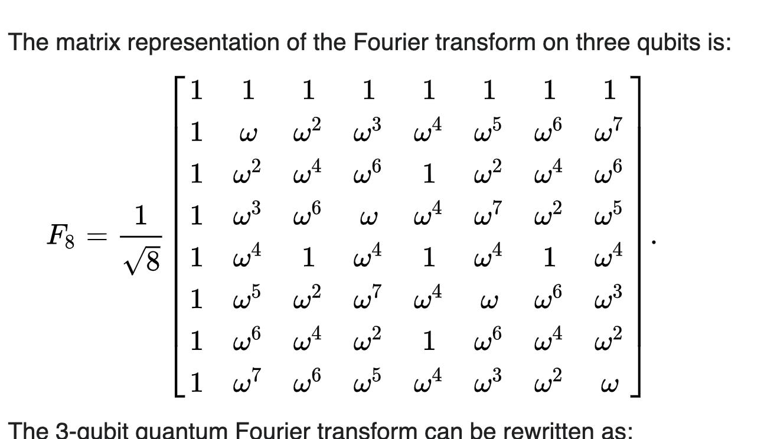
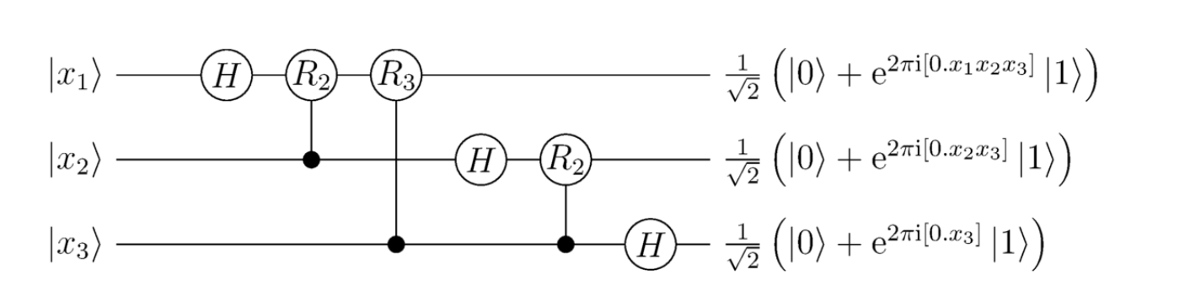
Quantum Fourier Transform
Input is an integer of row # (binary combined state rep.)
Output is a superposed state for each bit (along equator)
State Vector is passed through fourier matrix
Output is a superposed state with Relative Phase
Vector data Inputting
*Our bit convention is where the most significant bit is the bottom one*
Notes:
Circuit is for one row of the fourier transform matrix
To finish the fourier transform you have to input all the row numbers (starts from zero)

Slide 10
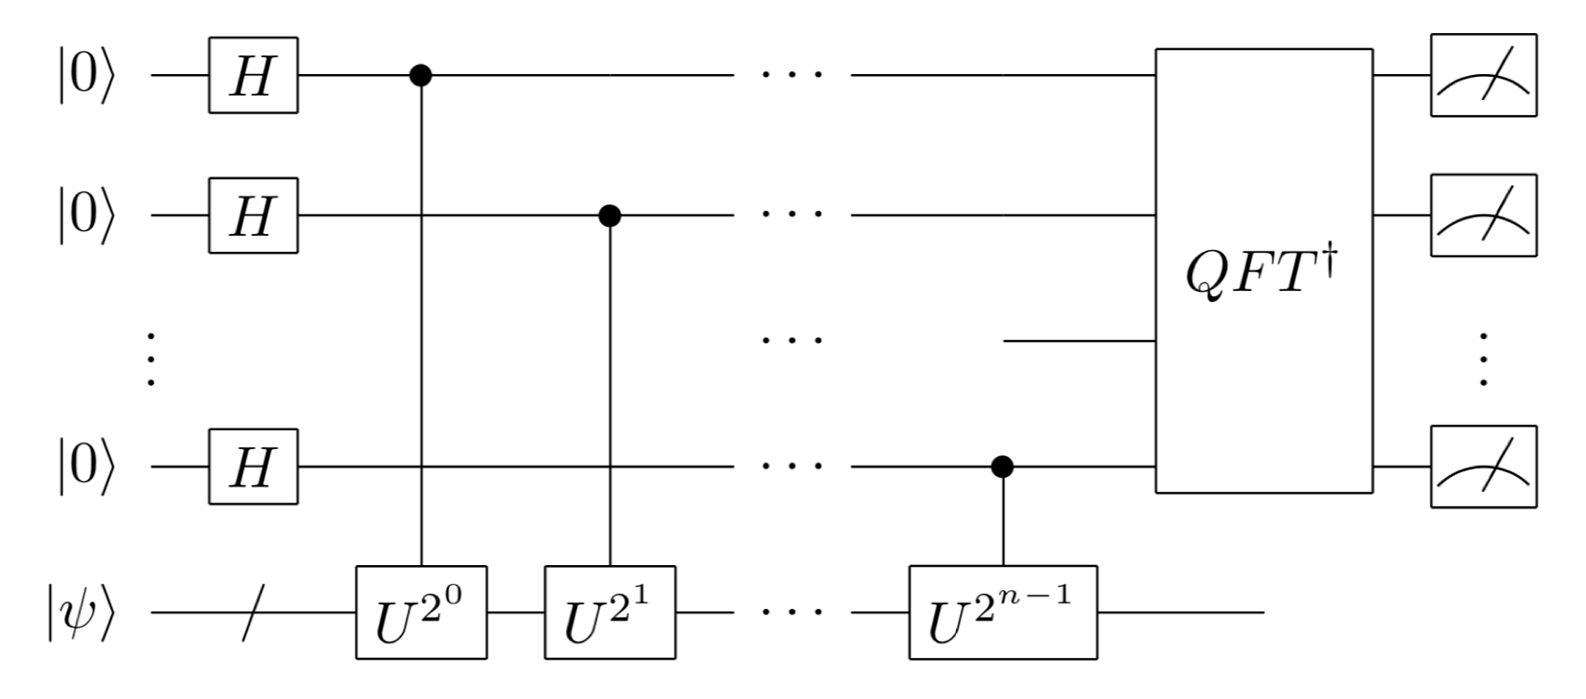
Quantum Phase Estimation
Used directly to solve Ax=b, (solution(x)=Σ(c_{i}*v_{i})/(λ_{i}))
Input in second register is eigenvectors of b (top register is all 0)
Output is essentially an angle on each qubit
Utilizes Inverse Fourier Transform
Matrix Data input
****Ax=b****
2^{n}*Θ=x (row #)
SOL(x)=Σ(ci*vi)/(λi)
Notes:
Row number is proportional to Lambda

Slide 11
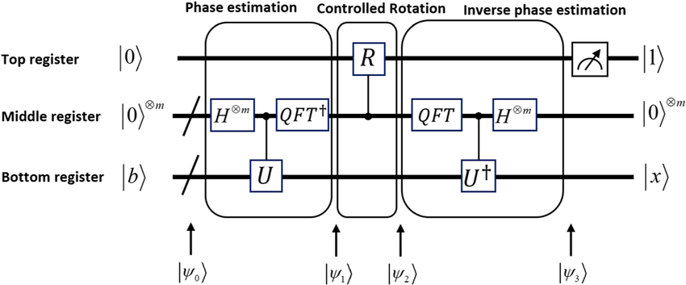
HHL Algorithm
Main Goal is to solve Ax=b
Based on Eigen Decomposition
Consists of 3 Sub Algorithms (Fourier transform, phase estimation, division)
Notes:
For classical computing there are many methods to solve Ax=b→ Direct vs iterative solving, only eigen decomp method works in quantum computing
(show equations for eigen decomp and to solve x,, x=sum(ci*vi/(lambda) )
Input U = Modified matrix A , eigen values are e^(lambda*i), eigenvectors are identical
Quantum circuit will generate that modified A to get your U matrix

Slide 12
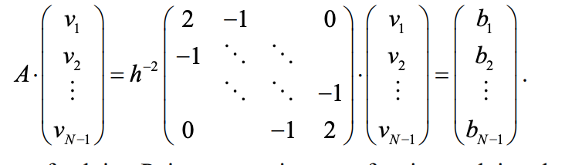
Quantum Diff EQ
Algorithms for Linear Equations currently outperform classical computers [umd]
Newer algorithms have been developed and tested for nonlinear equations
Potential applications include Navier stokes theorem, plasma hydrodynamics etc.. [Harvard]
Basis for Diff EQ algorithms come from Linear Algebra algorithms
*** Finite difference applied to poisson's equation **
Notes:
finite difference(1-21 matrix), POISSONS EQ. , carleman linearization [ converting into ax=b]
Any questi

Slide 13
Acknowledgements

